Slide 1
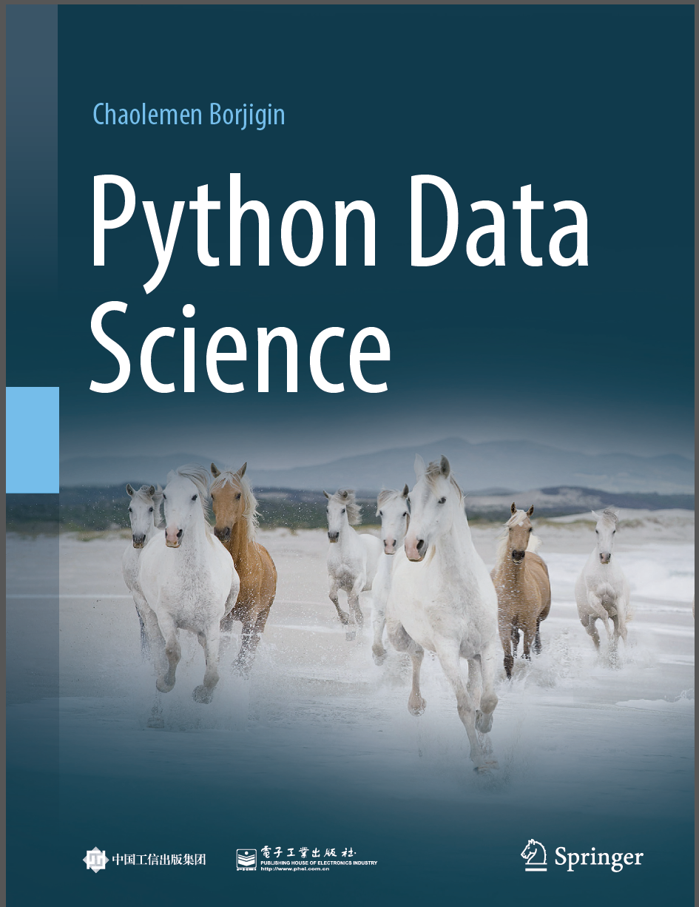
Python Data Science
Chaolemen Borjigin
Renmin University of China
chaolemen@ruc.edu.cn

Slide 2
3.2 Modules
▼ Chapter 3 Advanced Python Programming for Data Science
► 3.2 Modules
Chaolemen Borjigin
Renmin University of China
chaolemen@ruc.edu.cn

Slide 3
Summary of this chapter
▼ Chapter 3 Advanced Python Programming for Data Science
► 3.2 Modules
3.2.1 Importing and using modules
3.2.2 Checking built-in modules list

Slide 4
3.2.1 Importing and using modules
▼Chapter 3 Advanced Python Programming for Data Science
► 3.2 Modules
In[1]:
import math
math.sin(1.5)
Out[1]:
0.9974949866040544
In[2]:
cos(1.5)
---------------------------------------------------------------------------
NameError Traceback (most recent call last)
<ipython-input-2-edeaf624fe76> in <module>
----> 1 cos(1.5)
NameError: name 'cos' is not defined
Out[2]:

Slide 5
3.2.1 Importing and using modules
▼Chapter 3 Advanced Python Programming for Data Science
► 3.2 Modules
In[3]:
import math as mt
mt.sin(1.5)
Out[3]:
0.9974949866040544
In[4]:
from math import cos
cos(1.5)
Out[4]:
0.0707372016677029

Slide 6
3.2.2 Checking built-in modules list
▼Chapter 3 Advanced Python Programming for Data Science
► 3.2 Modules
In[5]:
import sys
sys.builtin_module_names
Out[5]:
0. ('_ast',
'_bisect',
'_blake2',
'_codecs',
'_codecs_cn',
'_codecs_hk',
……
'zipimport',
'zlib')

Slide 7


